Slide 1
Chapter 6: Data Mining Using Classic Statistical Techniques

Slide 2
Agenda
Similarity Models
Table Lookup Models
RFM: A Widely Used Lookup Model
Naïve Bayesian Models
Linear Regression
Multiple Regression
Logistic Regression
Fixed Effects and Hierarchical Effects

Slide 3
Similarity Models
A similarity model compares observations to be scored to a prototype.
The more the similar, the higher the similarity score
A similarity model consists of the prototype and a similarity function.
Score it by applying the similarity function to new data.

Slide 4
Example: A Similarity Model for Product Penetration
Business problem:
Hudson and Niagara Stove Company (H&N) is planning to expand from New York across Lake Champlain into the Vermont market
How can H&N use data from its home state to select good locations for dealerships in the new one?
Data Used for Similarity Model:
Publicly available data from the U.S. Census.

Slide 5
Steps for Building a Similarity Model
1. What distinguishes “good” records from “bad” ones?
2. What would the ideal “good” record look like?
3. How should distance from the ideal be measured?
The answers to these three questions provide the information needed to define the model.

Slide 6
Step 1: What Distinguishes High
Penetration Towns from Low Penetration Towns?
“What do the high-penetration towns have in common?”
“What do the high-penetration towns have in common that sets them apart from the low-penetration towns?”
A similarity model starts with descriptive statistics about the variables.
When characterizing differences based on response rates, average order sizes, or another target variable, you can get a clearer signal by removing cases near the middle in order to compare the extremes.

Slide 7
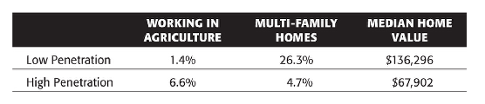
Step 2: What Would the Ideal Town Look Like?
Good candidates for describing the ideal wood-burning town:

Slide 8
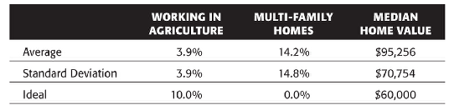
Step 3: How Far Is Each Town from the Ideal?
A distance function measuring the distance from the ideal
Averages and standard deviations for the selected variables

Slide 9
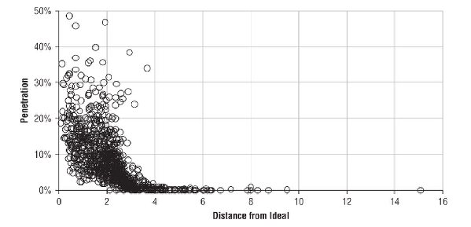
Evaluating the Similarity Model
How well does distance from the ideal correlate with penetration?
The Pearson correlation coefficient

Slide 10
Table Lookup Models
Things that are similar along multiple known dimensions have similar values for other attributes as well.
The first step is to choose input variables for its dimensions.
Any variables that are not already categorical are partitioned into ranges to create discrete attributes, such as “high,” “medium,” and “low.”
Dimensions of a lookup table (selling car as an example): make, model, model year, mileage range, body style, transmission type, engine size of a car

Slide 11
Choosing Dimensions
Each dimension should be a variable that has some impact on the value of the target.
Ideally, the input variables chosen should not be correlated with each other.
The practical effect of correlated variables is that some cells end up with few training examples, a situation that leads to estimates with low confidence.
There is a trade-off between the number of dimensions and the number of partitions along each dimension.

Slide 12
Partitioning the Dimensions
Partition categorical dimensions one per category.
Numeric dimensions are discretized by breaking them in ranges or bins.
The bins should have roughly equal numbers of training examples, so terciles or quintiles are convenient choices.

Slide 13
From Training Data to Scores
After you partition the dimensions, measuring the value of the target variable in each cell on the training set is a simple matter.
For numeric targets, the average value becomes the score.
For categorical targets, there is a score for each class — the proportion of each cell that has each class label.

Slide 14
Handling Sparse and Missing Data by Removing Dimensions
What if the cells do not have enough data to support the required confidence level?
Reduce the number of splits along each dimension
Reduce the number of dimensions used to define the sparse cells

Slide 15
RFM: A Widely Used Lookup Model
RFM is a familiar acronym for a type of model called Recency, Frequency, and Monetary.
R, F and M: three dimensions used for lookup model that estimate probability of response and order size
Logic of RFM model: Customers who recently purchased, made many purchases and spent a lot of money in the past would likely purchase in the future.
Works only for existing customers. Doesn’t work for prospective customers.

Slide 16
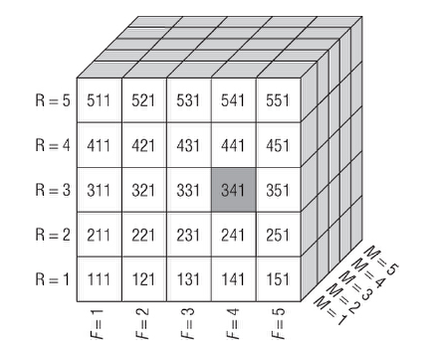
RFM
Each of the three RFM dimensions has been partitioned into quintiles to form an RFM cube with 125 cells.

Slide 17
RFM Cell Migration
With every campaign, customers shift RFM cells.
During the campaign, customers changed their frequency and monetary numbers and decrease their time since last purchase.
The new values often place the customers in a new cell.

Slide 18
RFM and the Test-and-Measure Methodology
RFM is often used in direct marketing contexts, where similar campaigns are run throughout the year.
Particular RFM cells will respond to the next campaign in a similar way they responded to the last one.
Blocking factors have a large effect on the target to create cells that are all similar with respect to the blocking factors.
RFM provides a natural blocking mechanism.
In direct marketing response modeling, recency, frequency, and spending are natural blocking factors.

Slide 19
New Types of Campaigns Should Be Tested Before Being Rolled Out
Before rolling out a new campaign, one should test it on a carefully constructed sample of customers who receive the proposed offer under conditions that mimic as closely as possible the conditions expected to prevail for the full campaign.
The test campaign uses treatment and control groups that include members of every cell.

Slide 20
RFM and Incremental Response Modeling
Goal of incremental response modeling: identify persuadable prospects
RFM and other cell-based methods are a good way to measure incremental response in addition to overall response by creating a treatment group and a hold-out group in every cell.
With RFM, this difference of response rates between these two groups can be determined on a cell-by-cell basis.

Slide 21
Naïve Bayesian Models
Naïve Bayesian models provide a way trying to predict a probability.
What naïve Bayesian models do: Predict the cancellation rate of “customers in Wyoming, acquired through direct mail, with credit class C, on rate plan G2, with a Blackberry, who are over 70.”

Slide 22
Some Ideas from Probability
Probability, Odds, and Likelihood
Probability: A number between 0 and 1 indicating the chance of a particular outcome occurring.
Odds: The ratio of the probability of a particular outcome occurring to the probability of it not occurring. The odds is a number between zero and infinity.
Likelihood: The ratio of two related conditional probabilities — the probability of a particular outcome A, given B, and the probability of outcome A, given not B.

Slide 23

Some Ideas from Probability
Reverend Bayes and His Law
A conditional probability relates the probability of A given B to the probability of B given A.
The probability of A given B is the probability of B given A times the ratio of the probabilities of A and B.

Slide 24


Converting for Convenience

Slide 25
The Naïve Bayesian Calculation
The reason that the calculation is called “naïve” is that multiplying all the likelihoods which assumes that the inputs are independent of each other.
The naïve Bayesian formula calculates the odds of target variable, given the likelihood of various inputs with respect to the target variable.

Slide 26
Comparison with Table Lookup Models
Differences:
How the dimensions are used.
Lookup models capture interactions among the variables.
Naïve Bayesian model calculated the likelihoods separately in for each dimension and then combined.
Prediction based on frequency in the training data
A table lookup model has nothing to say about combinations of attributes that do not occur with sufficient frequency in the training data
Naïve Bayesian model can make predictions about combinations that have never been seen

Slide 27
Linear Regression
Both the input and target variables must be numeric, and the regression equation describes an arithmetic relationship between them.
This relationship is “best” in the sense that it minimizes the sum of the squares of the vertical distances from the data points to the line.
Ordinary least squares regression

Slide 28
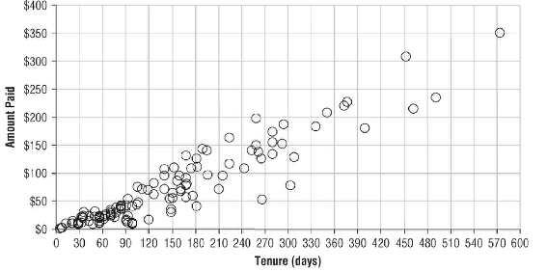
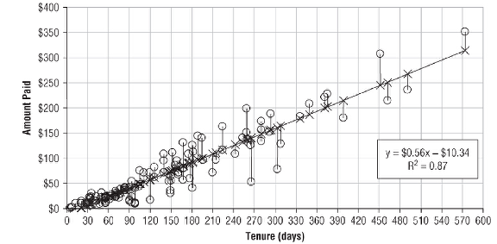
Where Ordinary Least Squares Regression Comes From
Ordinary least squares: the most common method for finding the best-fit line in linear regression is called.
The Best-fit Line:
Of all possible lines, it is the one where the sum of the squares of the vertical distances from the observed data points to the line is as small as possible.
Yy
t

Slide 29
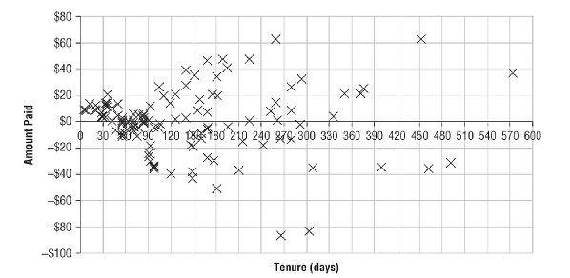
Goodness of Fit
How good is “best – fit line”?
A typical measure is the difference between the predicted and actual values, which are called the residuals.
Residuals
x

Slide 30

Residuals
The residuals are considered the error term in the regression equation.
The error term captures whatever portion of the variation in Y that is not explained by the model.

Slide 31
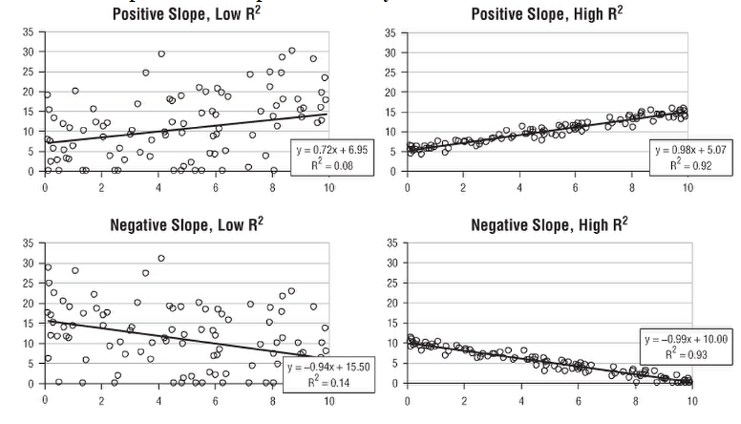
Coefficient of determination (R²)
The R² value always varies between zero and one for the best-fit line.
A high R² value implies that the points are very close to the line.

Slide 32
Global Effects
Regression equations find global patterns in the data.
Regression models are good at capturing patterns that are always true, but they struggle with local patterns.
Many of the data mining techniques, such as decision trees, neural networks, and memory-based reasoning, find local patterns as well as global ones.

Slide 33
Multiple Regression
The Equation
Y = β₀ + β₁X₁+ β₂X₂+ … + β_{n}X_{n}.
Target variable: Ys
Explanatory variables: Xs
Model coefficients: β
Constant term: β₀
The statistical problem is to calculate the betas

Slide 34
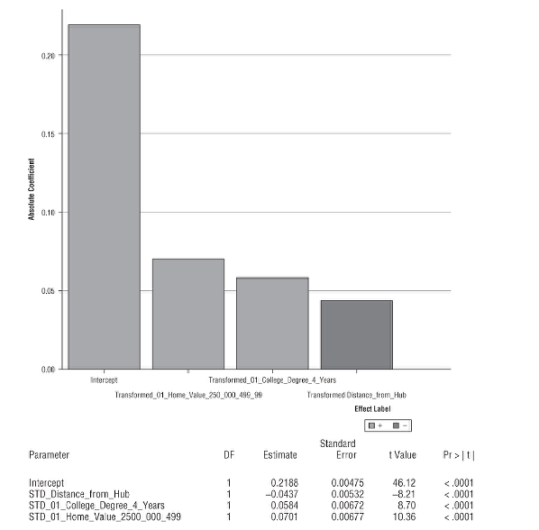
Multiple Regression
The Range of the Target Variable
infinite range vs link function
Interpreting Coefficients of Linear Regression Equations
The height of the bars shows the relative importance of the inputs.

Slide 35
Capturing Local Effects with Linear Regression
How can this local knowledge be used to improve the model?
Transform the distance variable.
Replace the distance variable.
Build separate models for towns close to Boston and towns farther away.

Slide 36
Additional Considerations with Multiple Regression
Linear Independence
Inputs to a multiple regression model should be uncorrelated.
Interactions
When two variables are completely independent, their effect on the target variable may not independent, which is called interactions
Adding Variables Can Change the Coefficients of Variables Already in the Model
Start with a very simple model of one input and then gradually increase its complexity by adding additional variables to the mix.

Slide 37
Variable Selection for Multiple Regression
Forward Selection
Starts with a set of input variables, each step chose one best variables based on tests, repeat the selecting process until the maximum desired number of variables has been selected or that no additional variable improves the model by more than some threshold value.
Stepwise Selection
Similar to Forward Selection. Each step add one variable and also possible remove one variable.
Backward Elimination
Begins by creating a multiple regression model using all n candidate input variables. Each step remove one variable until some stopping criterion.

Slide 38
Logistic Regression
Logistic regression is dealing with binary problems
Modeling Binary Outcomes
There are two categories, and the task is to assign each record to one or the other.
However, the task can be restated as “What is the probability that this record belongs to class one?” -- estimation task.

Slide 39
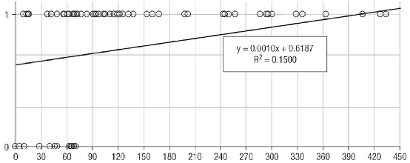
Modeling Binary Outcomes
Estimating Probabilities with Linear Regression
Bending the Regression Line into Shape
A linear regression model does a poor job of modeling the probability that a subscriber has ever paid.

Slide 40
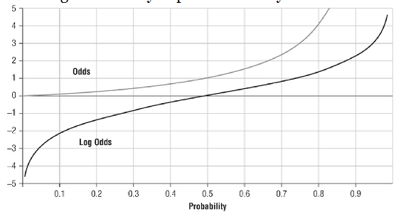

The Logistic Function
A comparison of odds and log odds.
the log odds as the target variable for the regression looks makes the regression equation look like:

Slide 41

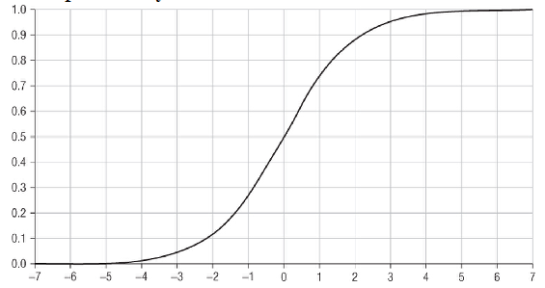
The Logistic Function
Solving for the probability p:
The logistic function goes from 0 to 1 just like a probability.

Slide 42
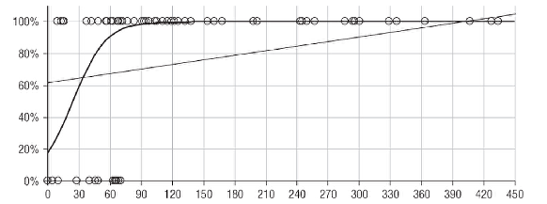
The Logistic Function
Logistic regression does a much better job of estimating the probability that a subscriber has paid.

Slide 43
Fitting Models by the MLE
Maximum Likelihood Estimator (MLE)
Use observed data to find parameter values that would calculate target values as similar as possible to the actual target values.
produce the best estimate for some value given a certain set of parameter values.
A numerical optimization technique is used to maximize the likelihood

Slide 44
Fixed Effects and Hierarchical Effects
Hierarchical Effects
Kid, class, school, states
Between Effects
when you want to control for omitted variables that change over time but are constant between cases
Typically time dummies are added
Fixed Effects
when you want to control for omitted variables that differ between cases but are constant over time.
Typically case dummies are added
Need to have multiple rows for the same case in order to run this.

